Slide 1
Editing and other types of Video Wizardry
Tricking your audience
into believing anything!

Slide 2
The iMovie Interface
Project Library
Timeline
Project Viewer
Event Library
Bin
Music, Title and Transition Effects
Import button

Slide 3
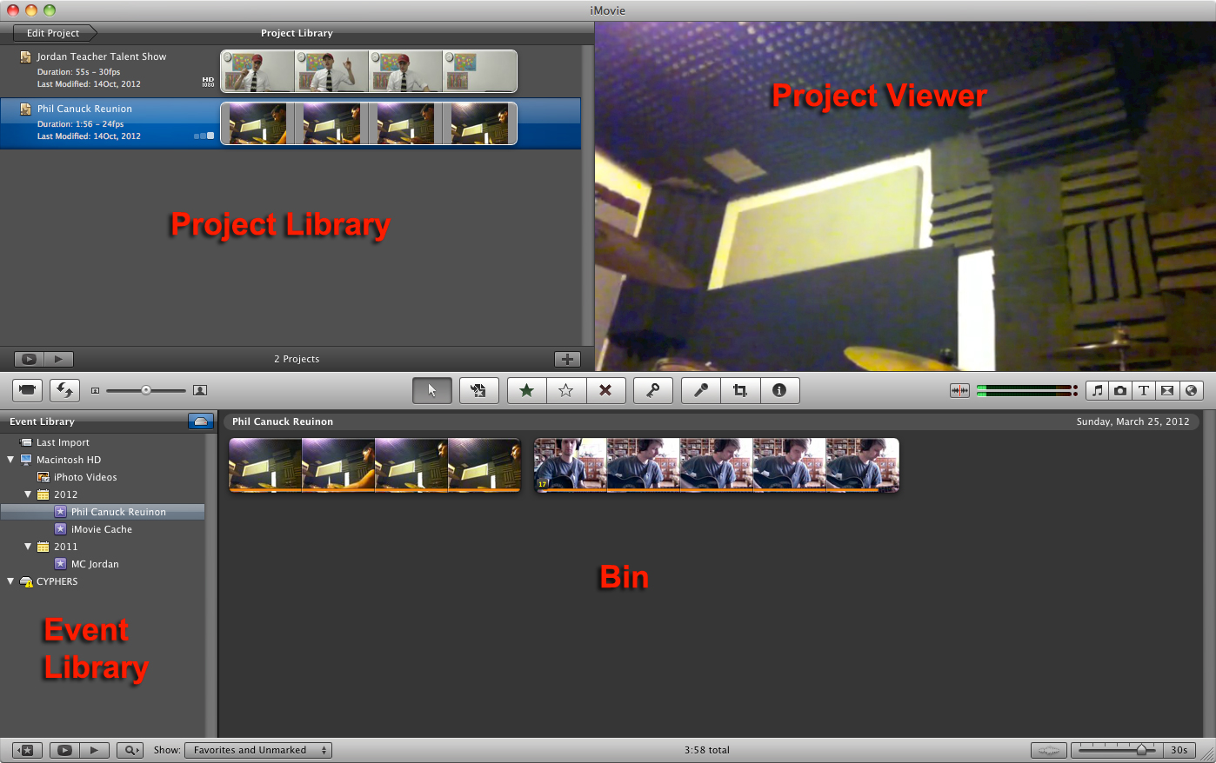

Slide 4
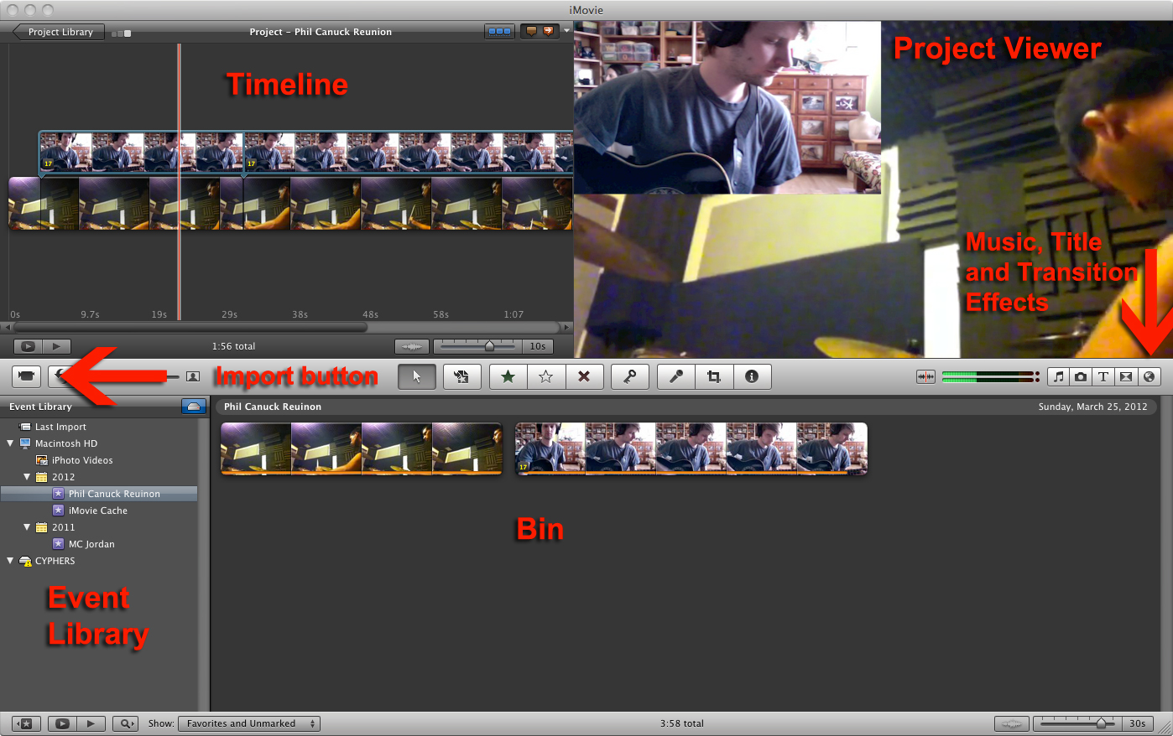

Slide 5
The “Grammar” of Video

Slide 6
The “Grammar” of Video
Frame ➔ Shot ➔ Sequence ➔ Scene ➔ Video

Slide 7
Editing Vocabulary
Cut
Trim
Splice
A-Roll
B-Roll
Jump Cut
180° Rule
Continuity

Slide 8
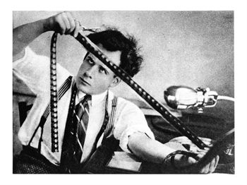
Cut
The process of deciding what will and will not be shown in the final video
Deciding where you want one shot to end and the next to begin

Slide 9
Trim
To remove part of the beginning or end of a clip

Slide 10
Splice
To cut a shot into multiple clips

Slide 11
A-Roll and B-Roll: That’s how we roll
A-Roll: The main footage for a project, as in an interview
B-Roll: Supporting footage - the extra stuff
Obsessives: Pizza
WE GOT B-ROLL!

Slide 12
Jump Cut
An abrupt transition from one shot to another
Grammar of Video: Jump Cuts

Slide 13
“Shoot to edit”
Shoot out of sequence
Keep rolling
Clear the frame!
Start and end with a static shot
Shoot multiple takes
Get coverage from multiple angles

Slide 14
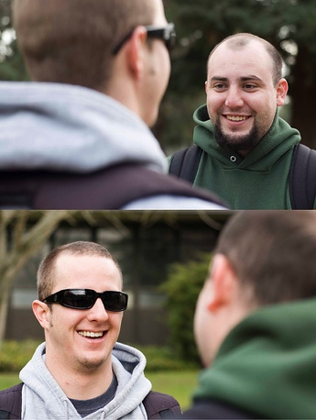
The 180° Rule
A rule governing the placement of the camera in a two-shot that ensures that characters always appear on the correct side of the screen
Shot-reverse-shot
Eyeline matching

Slide 15
The 180° Rule
Moviemaking Techniques/ The 180 Degree Rule
Filmmaking Tutorial 2:06
180 Degree Rule in Kobayashi Samurai Film

Slide 16
The 180° Rule

Slide 17
The 180° Rule
A rule governing the placement of the camera in a conversation that ensures that characters always appear on the correct side of the screen
Shot-reverse-shot
Eyeline matching

Slide 18
Practice: A Dialogue
With a partner you will write a short bit of dialogue, eight lines long (four lines per partner)
Frame up your shots interview style and record your conversation – be sure to follow the 180° rule.
Then, switch chairs and roles and record again
Remember to set your focus, white balance and exposure!

Slide 19
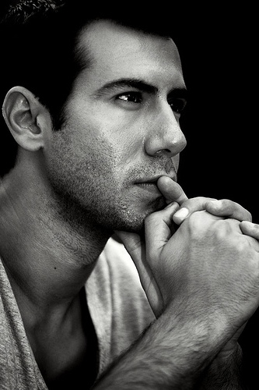
Practice: “Talking to Myself”
Each student: write a dialogue 6-8 lines long.
With a partner’s help: Film a close-up yourself saying half the lines.
Break the 180˚ Rule: Reposition the camera and film a close-up of yourself saying the other half of the dialogue.
When these shots are edited together it should look like you are talking to yourself!

Slide 20
Editing Vocabulary
Cut
Trim
Splice
A-Roll
B-Roll
Jump Cut
180° Rule
Continuity

Slide 21
Continuity
The complex craft of making many small parts into a coherent whole.
Maintaining consistency from shot to shot
Helps scenes make visual sense
More visually pleasing
Helps create an illusion of “real”

Slide 22
5 Types of Continuity
Continuity of Information
Continuity of Look
Continuity of Action
Continuity of Movement
Conventional Continuity

Slide 23
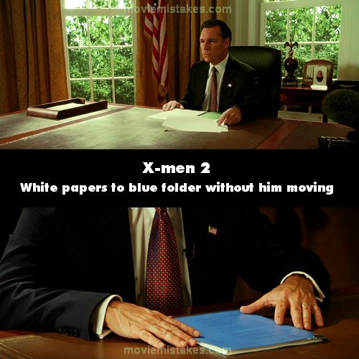
Continuity of Information
Continuity of Information concerns what is shown in the shot- what appears on screen.

Slide 24
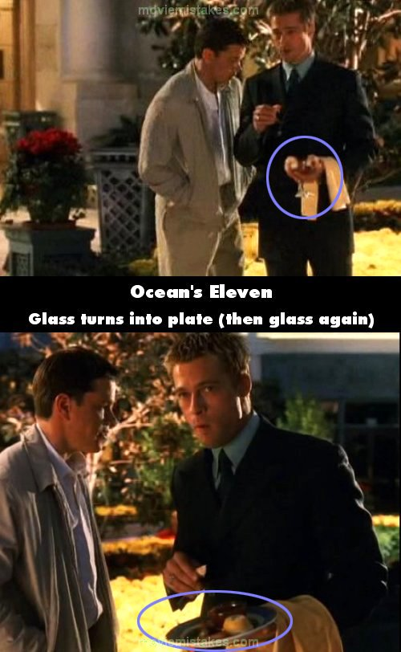
Continuity of Information
Your goal is for your audience to believe what they’re seeing is real.
Any mismatches or mistakes distract your audience!

Slide 25
“Your Editing Lacks Continuity”
Your Editing Lacks Continuity

Slide 26
Continuity of Information

Slide 27
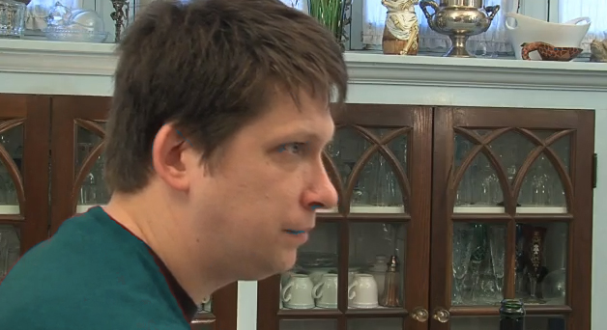
Continuity of Information

Slide 28
Continuity of Information

Slide 29
Continuity of Information
MASTER SHOT

Slide 30
Continuity of Information

Slide 31
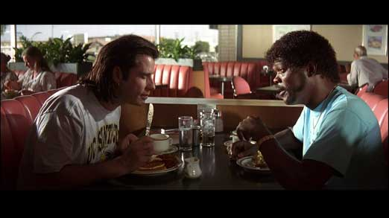
Continuity of Look
Maintain “screen direction”
In this shot, John Travolta is looking screen-right.

Slide 32
Continuity of Look
Maintain “screen direction”
In this shot, Samuel L. Jackson is looking screen-left.

Slide 33
Continuity of Look
This is the “Master Shot”

Slide 34
Continuity of Look
Do you know another name for this type of continuity?

Slide 35
Continuity of Look
You already know it. This is the 180 Degree Rule!

Slide 36
Continuity of Look
Eye line Matching

Slide 37
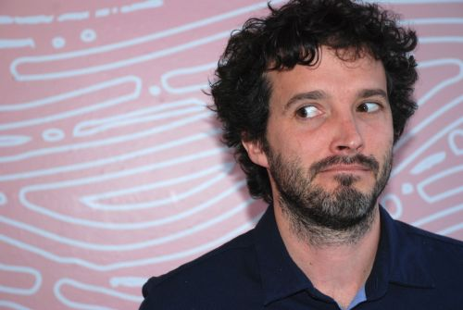
Glance-object pair

Slide 38
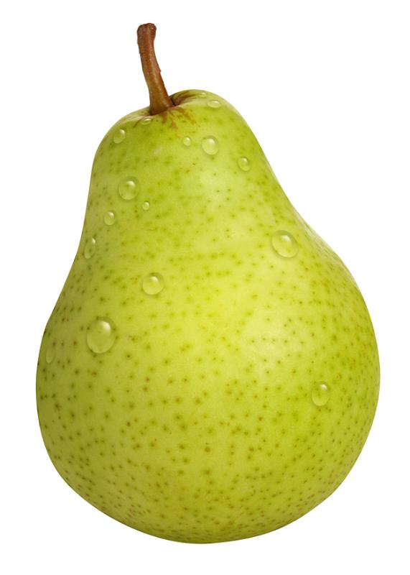
Glance-object pair

Slide 39
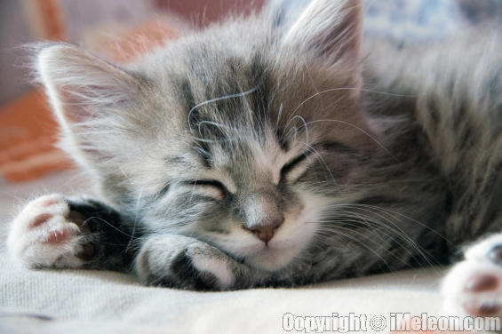
Glance-object pair

Slide 40
Glance-object pair

Slide 41
Practice: Create a Glance-object pair
Demonstrate the phenomenon of the “glance-object pair” by shooting one of your own!
Make sure that your glance makes sense with the placement of the object by using
“eye line matching”
Students may work in pairs, but each student must have his or her own glance-object pair.

Slide 42
Review: Continuity
What are the five types of continuity?

Slide 43
Review: Continuity
What are the five types of continuity?
What is continuity of look? What is another name for this?

Slide 44
Review: Continuity
What are the five types of continuity?
What is continuity of look? What is another name for this?
What is continuity of information?

Slide 45
Continuity of Action
Just as information should be consistent in a sequence or scene, an actor’s actions or activities should match from shot to shot
Hide your edits by cutting on action.
Cutting on action is an editing technique wherein an editor cuts from one shot to another shot that matches the action in the first shot. Although the shots might have been filmed hours or even days apart, cutting on the action gives the impression of continuous time when seen in the finished film.
Videomaker: Cutting on Action, In the Trenches: Cutting on Motion The Matrix

Slide 46
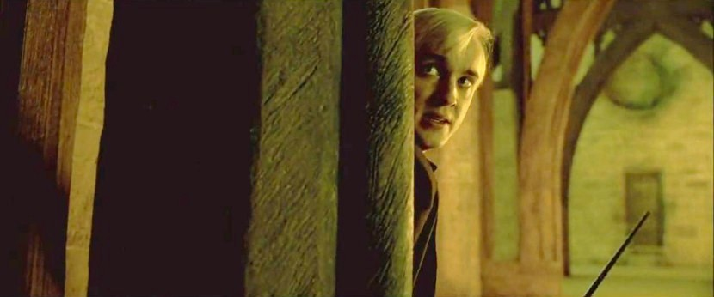
Continuity of Action
Practice: Entering a room
Create a short sequence of someone entering a room.
Shoot from two angles: once from inside the room and once from outside.
When you’re ready to edit, cut on the action to make your cut seamless.

Slide 47
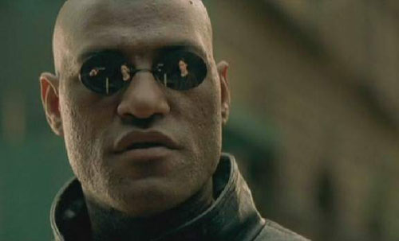
Continuity of Action
Practice: Matching the action
Cut between two shots seamlessly by hiding the cut
Shoot an action from two angles: a wide shot and a close-up.
When you’re ready to edit, cut on the action to make your cut seamless.

Slide 48
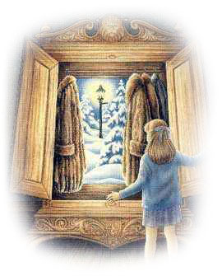
Continuity of Action
Practice: The Magic Door
Combine your knowledge of glance-object pairs with continuity of action to create the illusion that a normal school door opens up somewhere unexpected.
Shoot from multiple angles: once from inside the room and once from outside.
Use close-ups and cutaways if necessary to create an illusion.
Remember- you can make your audience believe anything!

Slide 49
Continuity of Movement
?
?

Slide 50
Continuity of Movement
What is Screen Direction?
?
?

Slide 51
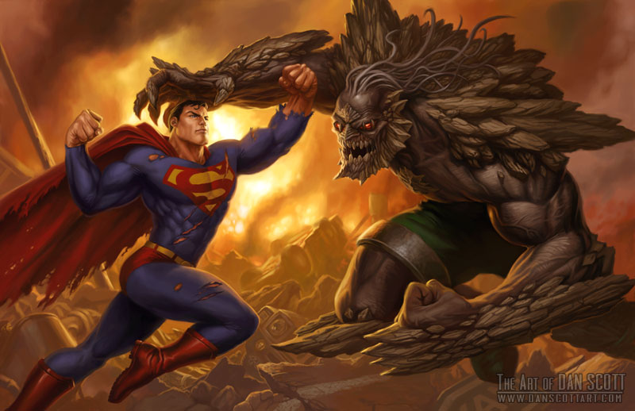
Continuity of Movement

Slide 52
Continuity of Movement

Slide 53
Continuity of Movement

Slide 54
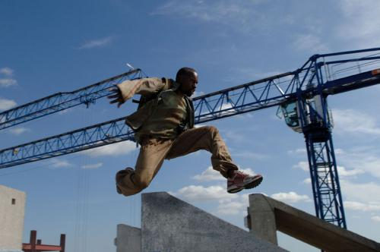
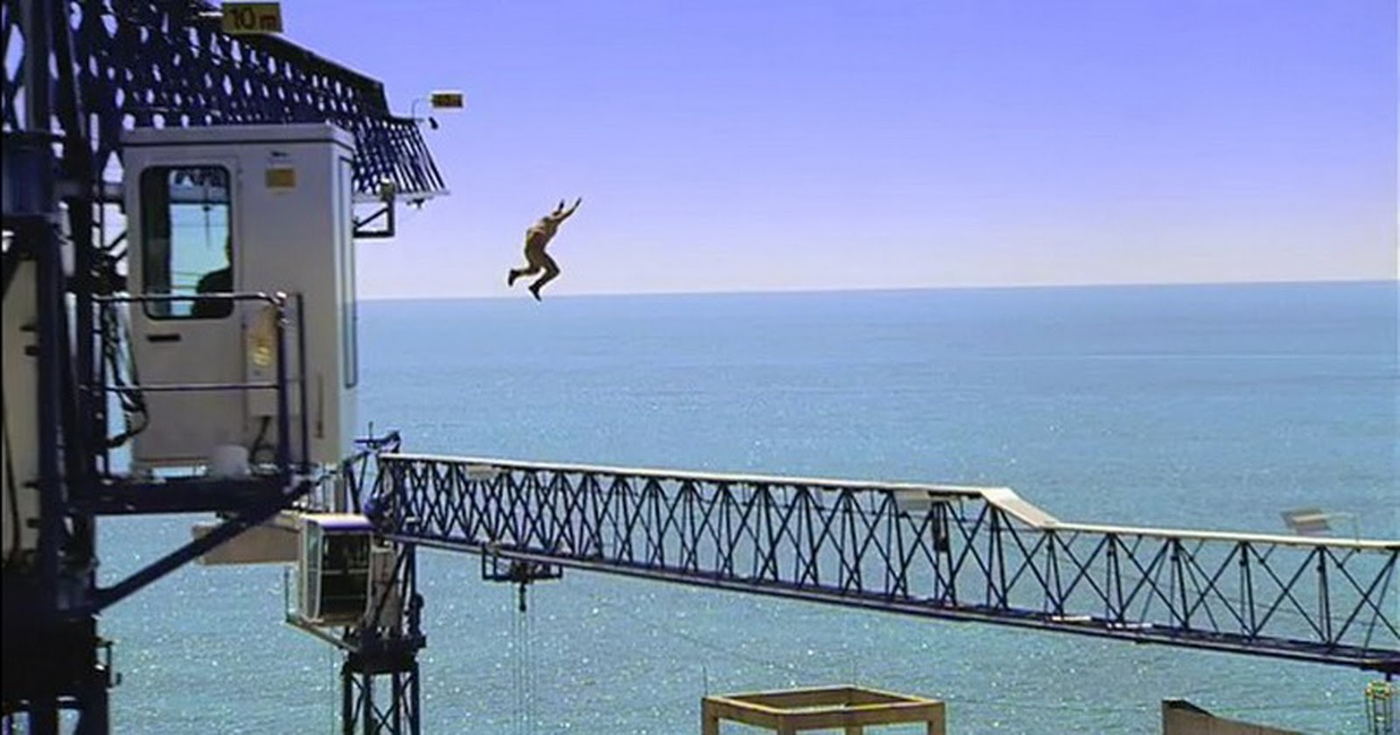
Continuity of Movement
Characters starting from the same place and moving in the same screen direction are racing or in pursuit.

Slide 55
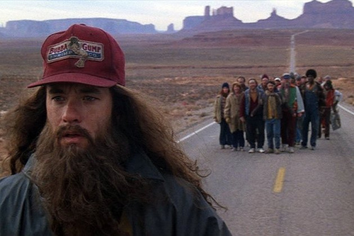
Continuity of Movement
Characters starting from different places and moving in the same screen direction are bound for the same destination.

Slide 56
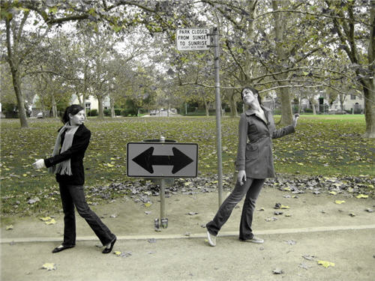
Continuity of Movement
Characters starting from the same place and moving in different directions are moving away from each other.

Slide 57
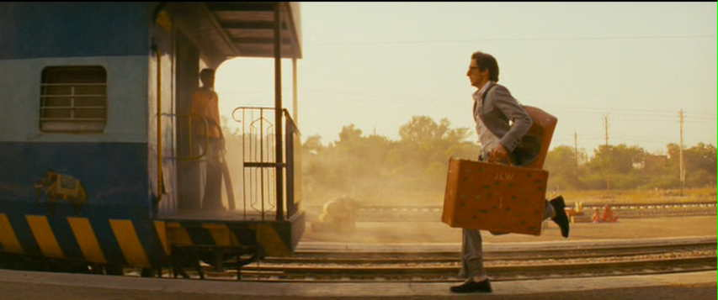
Continuity of Movement
Characters starting from different places and moving in opposite directions are acting independently of each other.

Slide 58
SCREEN DIRECTION EXERCISE
Characters starting from the same place and moving in the same screen direction are racing or in pursuit.
Characters starting from different places and moving in the same screen direction are bound for the same destination.
Characters starting from the same place and moving in different directions are moving away from each other.
Characters starting from different places and moving in opposite directions are acting independently of each other.
THIS IS DUE BEFORE FRIDAY’S CLASS
Composition | 5 | 4 | 3 | 2 | 1
Exposure | 5 | 4 | 3 | 2 | 1
Focus/White Balance | 5 | 4 | 3 | 2 | 1
Camera Movement | 5 | 4 | 3 | 2 | 1
Editing | 5 | 4 | 3 | 2 | 1

