Slide 1
Exposure
Let’s talk about

Slide 2
Do you ever have footage that looks like this?
Notes:
What’s wrong with this?

Slide 3
Exposure
In the simplest terms, exposure is the amount of light allowed to enter the camera

Slide 4
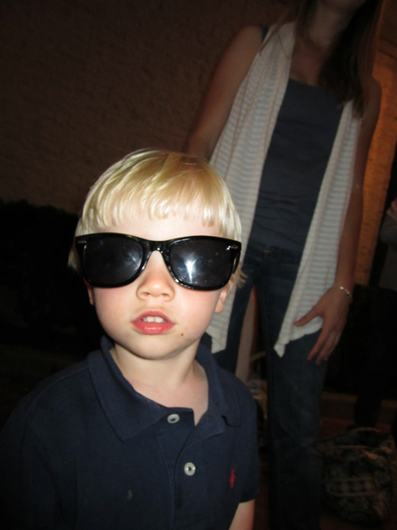
The world is a bright place.
Did you know that a subject lit by the midday sun on a beach looks over four thousand times brighter to your camera than the same subject lit by the quarter moon!

Slide 5
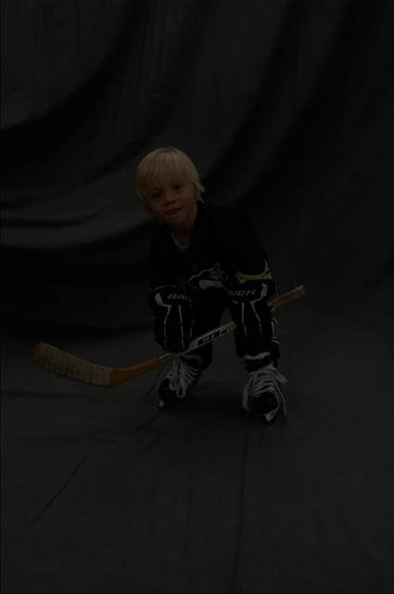

Slide 6
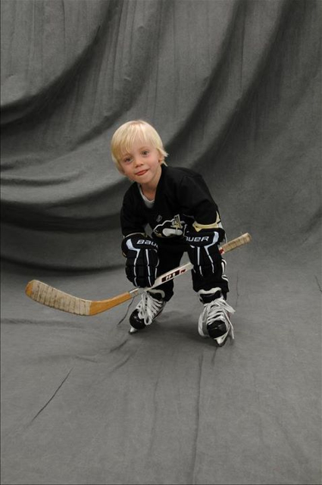

Slide 7
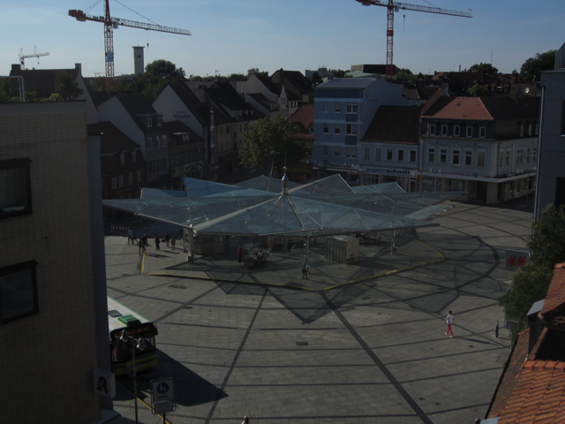
Underexposed
Notes:
What’s wrong with this?

Slide 8
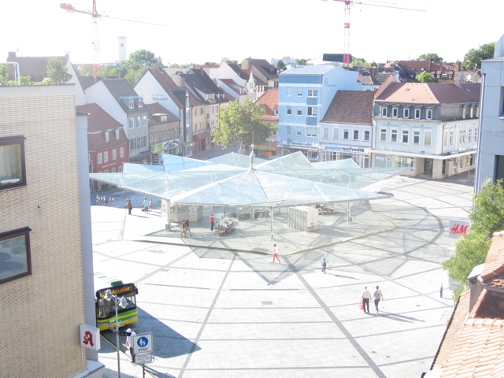
Underexposed
Overexposed
Notes:
What’s wrong with this?

Slide 9
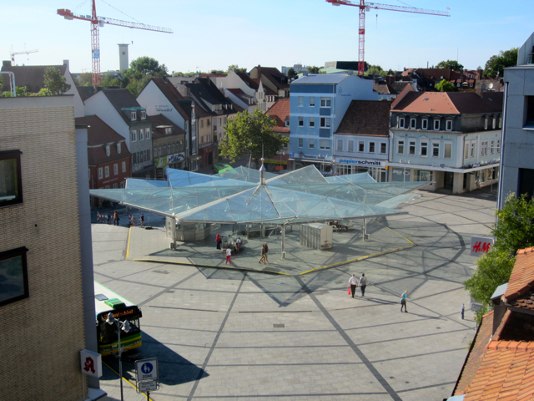
Underexposed
Overexposed
Correctly
exposed
Notes:
What’s wrong with this?

Slide 10
Aperture
The aperture is an adjustable iris (circle, hole, opening or entrance pupil) to the lens that adjusts based on your settings and conditions
We can control the brightness of a shot by opening and closing the iris to let more or less light into the camera

Slide 11
Iris
Notes:
What’s wrong with this?

Slide 12
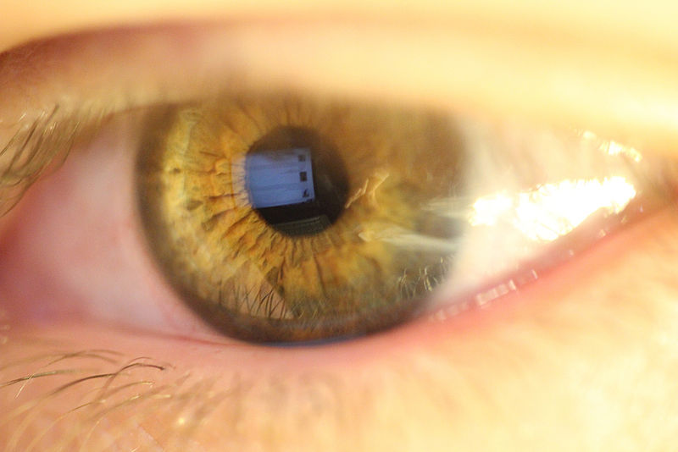
Iris
Notes:
What’s wrong with this?

Slide 13
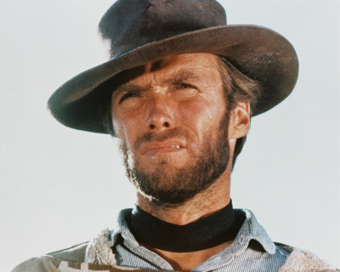
Iris
Notes:
What’s wrong with this?

Slide 14
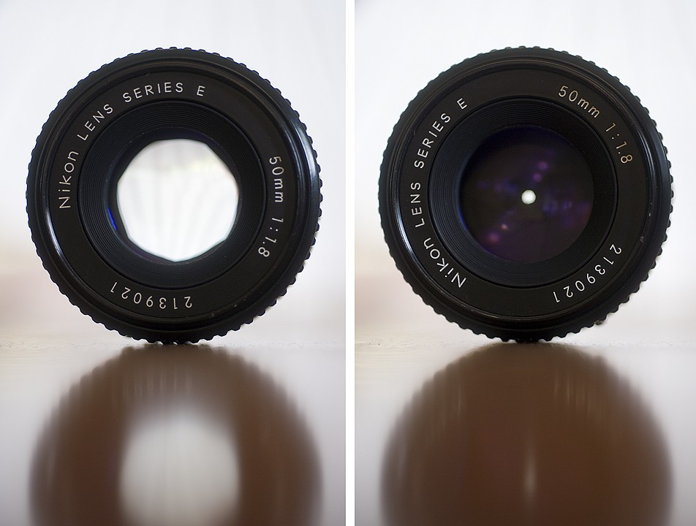
Aperture

Slide 15
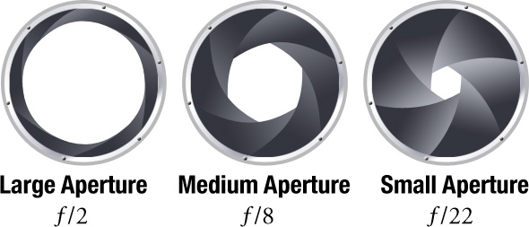
Aperture
Aperture is measured in “f-stops”.
A low f number means a wider opening allowing more light in.

Slide 16
Let’s Review:
A shot is brighter or darker based on the exposure.
Exposure is changed by adjusting the aperture.
The aperture of the camera expands and contracts like the iris in your eye.
Aperture is measured in “f-stops”.
A low f number means a wider opening allowing more light in.

Slide 17
Let’s Review:
A shot is brighter or darker based on the exposure.
Exposure is changed by adjusting the aperture.
The aperture of the camera expands and contracts like the iris in your eye.
Aperture is measured in “f-stops”.
A low f number means a wider opening allowing more light in.

Slide 18
Let’s Review:
A shot is brighter or darker based on the exposure.
Exposure is changed by adjusting the aperture.
The aperture of the camera expands and contracts like the iris in your eye.
Aperture is measured in “f-stops”.
A low f number means a wider opening allowing more light in.

Slide 19
Let’s Review:
A shot is brighter or darker based on the exposure.
Exposure is changed by adjusting the aperture.
The aperture of the camera expands and contracts like the iris in your eye.
Aperture is measured in “f-stops”.
A low f number means a wider opening allowing more light in.

Slide 20
Let’s Review:
A shot is brighter or darker based on the exposure.
Exposure is changed by adjusting the aperture.
The aperture of the camera expands and contracts like the iris in your eye.
Aperture is measured in “f-stops”.
A low f number means a wider opening allowing more light in.

Slide 21
Underexposed
Overexposed
Correctly
exposed
Notes:
What’s wrong with this?

Slide 22
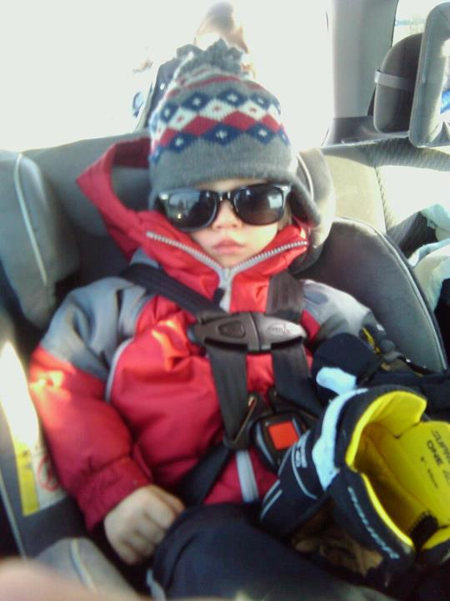
Knowing how to adjust your exposure is cool.

