Slide 1
Storytelling: The Basics of Plot

Slide 2
Storytelling: The Basics of Plot
Plot: The structure of the story. The plot is the arrangement or order of the events in a story.

Slide 3
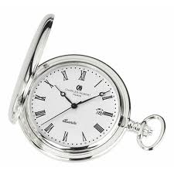
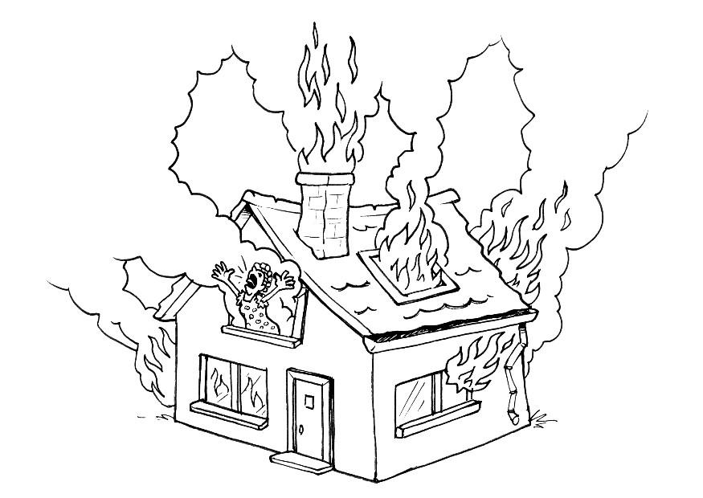
Types of linear plots
Chronological
Flashback
In medias res (In the middle of things) – when the story starts in the middle of the action without much exposition.

Slide 4
Aristotle’s Unified Plot
The basic triangle-shaped plot structure was described by Aristotle in 350 BCE.
Aristotle defined plot as comprised of three parts: beginning, middle, and end.
Aristotle called this narrative structure a unified plot. The parts of a unified plot are linear, leading from one to the next in a cause and effect chain as it builds toward the solution of a conflict or crisis.
Middle
Beginning
End

Slide 5
Pyramid Plot Structure
Exposition: The characters and setting are introduced.
Rising Action: The series of conflicts and crisis in the story that lead to the climax.
Climax: The turning point, the most intense moment—either mentally physically.
Falling Action: The wind down. All of the action which follows the climax.
Resolution: The conclusion, the tying together of all of the threads.
Climax
Rising Action
Falling Action
Exposition
Resolution

Slide 6
Pyramid Plot Structure
Exposition: The characters and setting are introduced.
Rising Action: The series of conflicts and crisis in the story that lead to the climax.
Climax: The turning point, the most intense moment—either mentally physically.
Falling Action: The wind down. All of the action which follows the climax.
Resolution: The conclusion, the tying together of all of the threads.
Climax
Rising Action
Falling Action
Exposition
Resolution

Slide 7
Pyramid Plot Structure
Exposition: The characters and setting are introduced.
Rising Action: The series of conflicts and crisis in the story that lead to the climax.
Climax: The turning point, the most intense moment—either mentally physically.
Falling Action: The wind down. All of the action which follows the climax.
Resolution: The conclusion, the tying together of all of the threads.
Climax
Rising Action
Falling Action
Exposition
Resolution

Slide 8
Pyramid Plot Structure
Exposition: The characters and setting are introduced.
Rising Action: The series of conflicts and crisis in the story that lead to the climax.
Climax: The turning point, the most intense moment—either mentally physically.
Falling Action: The wind down. All of the action which follows the climax.
Resolution: The conclusion, the tying together of all of the threads.
Climax
Rising Action
Falling Action
Exposition
Resolution

Slide 9
Pyramid Plot Structure
Exposition: The characters and setting are introduced.
Rising Action: The series of conflicts and crisis in the story that lead to the climax.
Climax: The turning point, the most intense moment—either mentally physically.
Falling Action: The wind down. All of the action which follows the climax.
Resolution: The conclusion, the tying together of all of the threads.
Climax
Rising Action
Falling Action
Exposition
Resolution

Slide 10
Pyramid Plot Structure
Exposition: The characters, setting and conflict (problem) are introduced.
Rising Action: The series of conflicts and crisis in the story that lead to the climax.
Climax: The turning point, the most intense moment—either mentally physically.
Falling Action: The wind down. All of the action which follows the climax.
Resolution: The conclusion, the tying together of all of the threads.
Climax
Rising Action
Falling Action
Exposition
Resolution

Slide 11
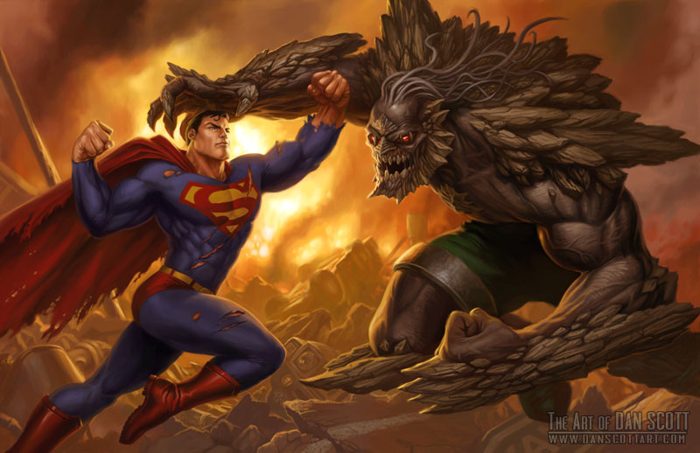
Conflict
Conflict is the dramatic struggle between two forces in a story. Without conflict, there is no plot.

Slide 12
Types of conflict
Man vs. man
Man vs. society
Man vs. nature
Man vs. self

