Slide 1
WHITE BALANCE
For Video

Slide 2
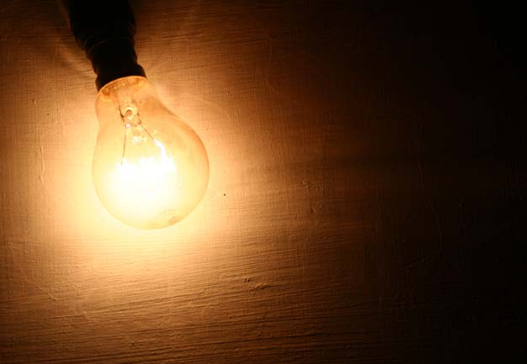
Is all light created equal?

Slide 6
How does your eye work?

Slide 7
How does a camera lens work?

Slide 8
Your eye is constantly making adjustments in different types of light. When you come in from outside, or enter a bright environment from a darkened room, your eye adjusts to the new light source quickly. A camera lens, built to mimic the human eye, cannot do this as easily.

Slide 9
“Cooler” and “Warmer”

Slide 10
“Color temperature”
Color temperature is a way of measuring the quality of a light source. It is based on the ratio of blue light to red light.
The unit for measuring this ratio is in degrees Kelvin (K).
A light with higher color temperature has "more" blue lights than a light with lower color temperature
Thus, a cooler light has a higher color temperature. The following table shows the color temperature of some light sources:

Slide 11
“Color temperature”
Temperature Light Source
1000-2000 K Candlelight
2500-3500 K Tungsten Bulb (household variety)
3000-4000 K Sunrise/Sunset (clear sky)
4000-5000 K Fluorescent Lamps
5000-5500 K Electronic Flash
5000-6500 K Daylight with Clear Sky (sun overhead)
6500-8000 K Moderately Overcast Sky
9000-10000 K Shade or Heavily Overcast Sky

Slide 12
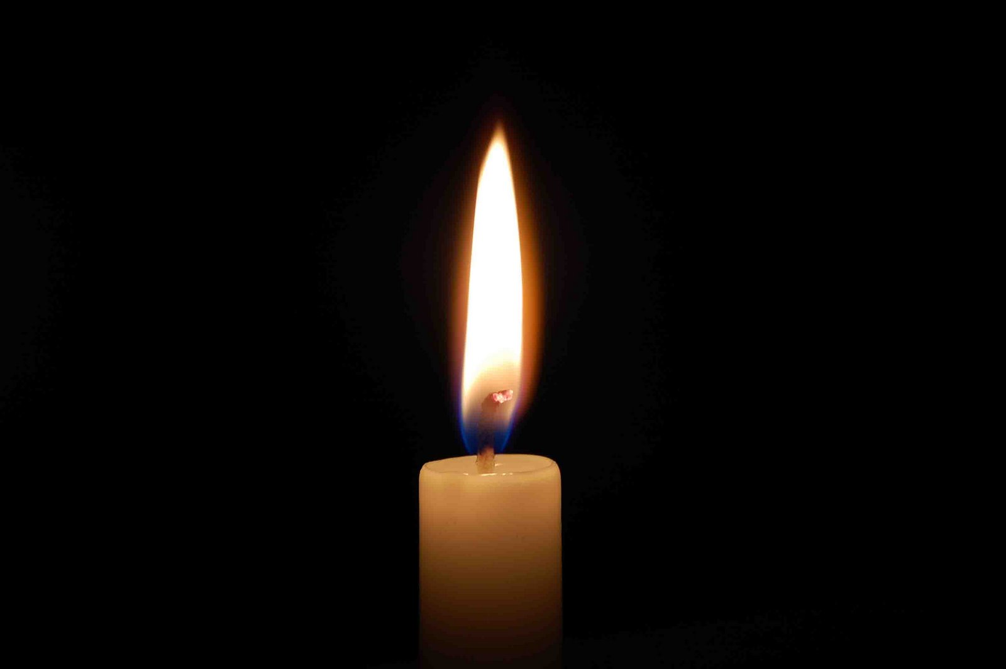
“Which part of the flame is hottest?”

Slide 13
Incandescent Light
Redder light = 3200˚K

Slide 14
Fluorescent Light
Bluer Light= 4000˚-5000˚K

Slide 15
Sunlight (on a clear day)
Bluer Light= 5600K

Slide 16
White Balance makes good color in your shots!
“If the light used to illuminate the original scene is not white, the colors in the image will be skewed toward the predominant color produced by the light source.
Such images are incorrectly white balanced and all the
colors in the image will be off balance.”

Slide 17
White balance camera settings

Slide 18
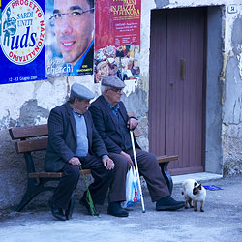
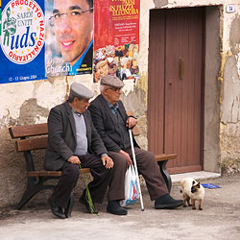
Which shot is correctly white balanced?

Slide 19
Which shot is correctly white balanced?
Incorrect

Slide 20
Which shot is correctly white balanced?
Incorrect
Correct

Slide 21
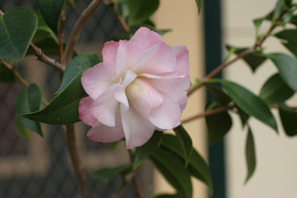
Creative White Balance
AWB

Slide 22
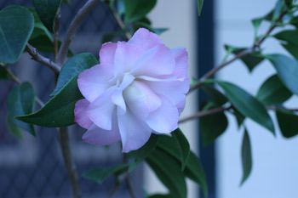
Creative White Balance
2800 K

Slide 23
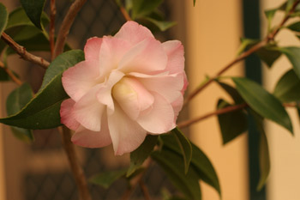
Creative White Balance
10,000K

Slide 24
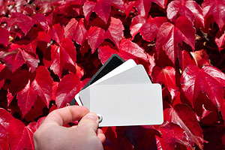
Remember:
Always white balance BEFORE you shoot!

Slide 25
Creative White Balance
http://www.cambridgeincolour.com/tutorials/white-balance.htm

